Slide 1
Customer Data Discovery
Billing Operations & AMO
July 8th, 2020

Slide 2
Agenda – Billing Operations & AMO Discovery
Introduction & Objectives – engagement purpose (as-is & to-be data capability assessment, data roadmap and investment sizing)
Confirm Billing Ops & AMO Scope & Capabilities – process-centric summarization & platform leverage
End-To-End Data Flows – provide high-level input into upstream, real-time and downstream as-is data domains and pain points
Discuss Future-State Customer “Golden Record” Perspectives – drivers of future customer data model from Billing Operations & AMO vantage
5 mins
15 mins
20 mins
20 mins

Slide 3
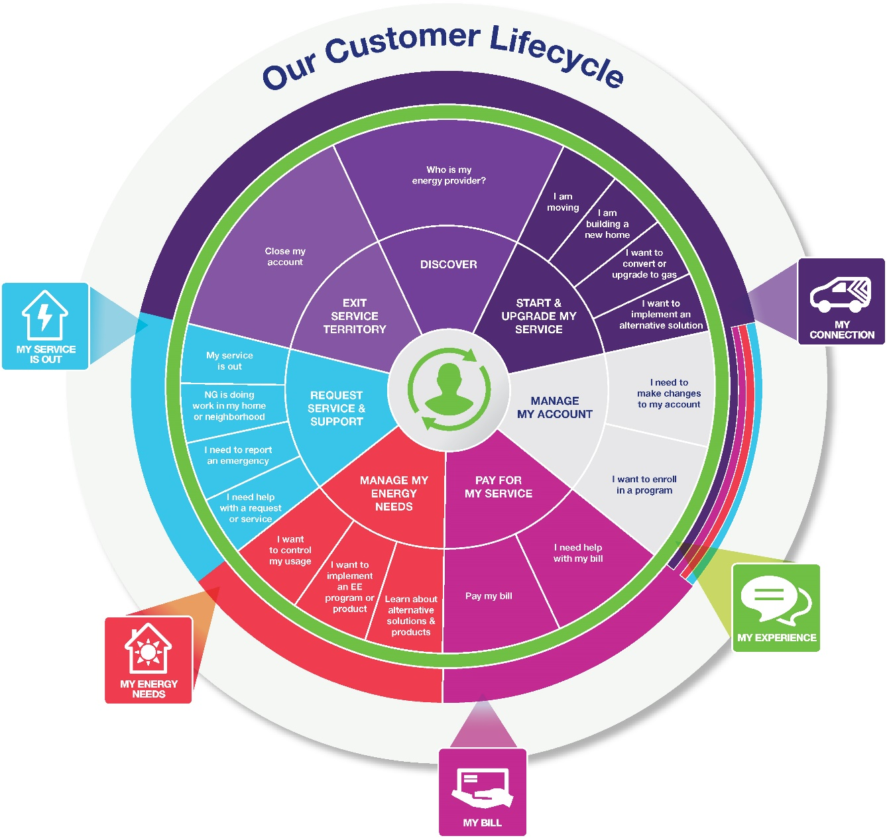
Billing Operations & AMO – Journey Segments
1
Bill Set-Up
1
2
Bill Payment
3
Bill Assistance
3
4
2
Close My Account
4
Notes:
Don’t do it just because there is a deadline.

Slide 4
Billing Operations & AMO – Targeted Outcomes (from Capabilities/Pain Points)
1
2
Bill Set-Up
Bill Pay
Sufficient CIS detail for common bill format
Linked accounts (multi-meter, multi-residence)
Customer selected due date
Pre-set allocation of payments among multiple accounts
Seamless auto-bill enrollment
Seamless payment support/deferred payment program enrollment
Seamless budget/balance billing enrollment
Personalized recommendations related to billing and payment plan offerings based on qualifications
Incentives/rewards/rebates for on-time payment
Customer selected preferences for credit application
Clearly articulated payment options (channels and formats) and implications of not paying
Automated payment posting and confirmations (to avoid lost payments) Allocated payments notification for multiple account application
Preference center and omni-channel confirmations of payment received
Roaming EV rate data
Customer ability to set-up and forecast energy budgets to proactively manage bills

Slide 5
Billing Operations & AMO – Targeted Outcomes (from Capabilities/Pain Points)
3
4
Bill Assistance
Close My Account
Predicted energy costs during month
Billing questions answered on preferred channel
Bill issues resolved quickly
Payment play/payment decision support
Bill calculations and bill explanations
Self-service bill diagnostics
Customer receives final bill estimate on day of move out
Customer can select date on which service will be stopped
Customer can understand timeline for stopping service (transparency)
Customer receives confirmation that service has been terminated
Customer can select channel that they will receive their final bill at the time, and in the channel, that they schedule their move out
Customer can pay their final bill and verify that account balance is zeroed

Slide 6


Information Flow Analysis – where does Billing Ops and AMO play?
Products/
Services
Contact /
Customer
Profile /
Preferences
Lead /
Opportunity
Location
(Premise)
Case
(e.g. Application/
Work Order
Complaint)
Customer
/ Account
Asset
(e.g. Meter /
Product
Thermostat)
Usage
(Meter
Reading)
Bill /
Payment
GL
Account
Data Domain
Market / Sales
Market / Sales
Market / Sales
Service
Service
3
Service
Asset
Asset
Bill/Pay
Finance
Need to align with Electric and Gas Ops Flows
Need to align with Electric and Gas Ops Flows
CSS Transaction Web
1
CRIS Transaction Web
Need to end to end process for Lead/Opportunity for all products
Application Portal (DG/Electric)
Need to add metering systems for input into CIS systems
Marketplaces (EE/EV Products)
2a
Need details Marketplace - Reimbursements for LC&I, Small Business and Trade Partners via DSM. Manual and Automated Flows
Questline / MC (Marketing Comm)
2b
Kubra (Outage Comms)
email
Right Now
CRM Sales (Grid Force)
In-Demand (DSM/EE Program Mgt.)
Applications
CRIS (Gas –NYC,MA)
CSS (Gas, Elec, DG)–UNY,MA,RI,LI)
CRM Service (GBE-RI)
MITS (CSS) / SPIPE / DIS (CRIS)
GIS
Maximo / MDSI
Need to find more details about CRIS GIS Feed
Storms / Mwork / MDSI (LI)
OMS (Outage)
SAP ECC6
CEMP 3rd Party (Uplight / O-Power)
4
CIAP
Customer
Data Platforms
ADA
CDI
CCAE
CSS (Revenue) Data Warehouse
CSQ / Trends
Automated API
Automated Replication
Single data master agreed
No Explicit Master / Implied
Data mastered in multiple applications
(This includes across all Jurisdictions)
DB Link
Manual replication
Notes:
Don’t do it just because there is a deadline.

Slide 7
Master Data Flows
Billing Operations & Account Management Perspectives
Multiple Systems of Record and pathways for account management and customer billing support
Fragmented non-utility billing and credit/rebate management
Meter-centric revenue management conflicting with C&I account management (bill aggregation, third-party bill agent management, C&I account servicing)

Slide 8
Data Flow Challenges – Billing Operations & Account Management?
For Discussion
Working across multiple Systems of Record
Timeliness of account and transactional updates across data sets
Ability to trace postings/allocations/credit transactions across Systems of Record
Situational awareness – ability to quickly aggregate and see what the customer sees on multiple fronts:
History of billing challenges
Track record of payment timeliness, billing assistance and payment agreement execution
Current or forecasted billing changes
Account set-up or transition status
Case management and proactive engagement around billing exceptions, payment issues, account issues

Slide 9
Future Systems & Data Implications
For Discussion
Account Creation
Billing & Account Servicing
C&I
Future State Capability Needs
Integrated platform for on-line customer account initiation or transfer including:
Core billing account set-up
On-line account and portal access
On-line bill rendering preferences
Automated payments processing preferences
Proactive and ongoing push for customer billing and payment channel enablement and self-service
Bill forecasting and expectation mgmt.
Streamlined bill/payment communications and feedback loops
Integrated bills and payment allocations (including rebates, incentives)
On-line bill analysis and support
Integrated Billing and Payment Support across delivery including enhanced Account Manager Capabilities
Customer Data Implications

Slide 10
Data Flows
Live Discussion
Billing Operations & Account Management
Pain Points
Upstream Data
Transactional Data
Downstream Data
?
Notes:
Don’t do it just because there is a deadline.

Slide 11
Notes
Live Discussion
?
Notes:
Don’t do it just because there is a deadline.

